Slide 1
Pivotal Cloud Foundry
Workshop Wrap-up
Pivotal and Perficient
April 2018

Slide 2
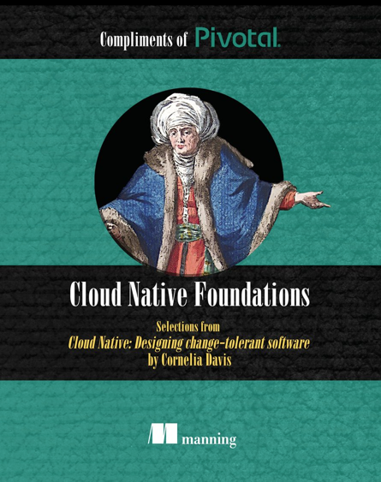
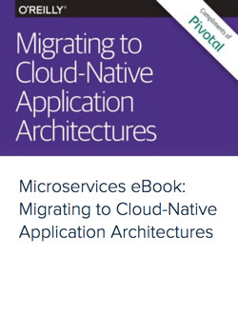
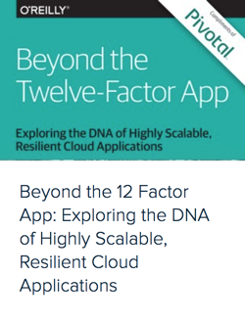
Pivotal eBooks
Suggestion: - Cloud Native Foundations - Migrating to CNA Architectures - Beyond the 12-Factor App - Cloud Foundry - the CN Platform - ... Download free eBooks at: https://content.pivotal.io/ebooks

Slide 3
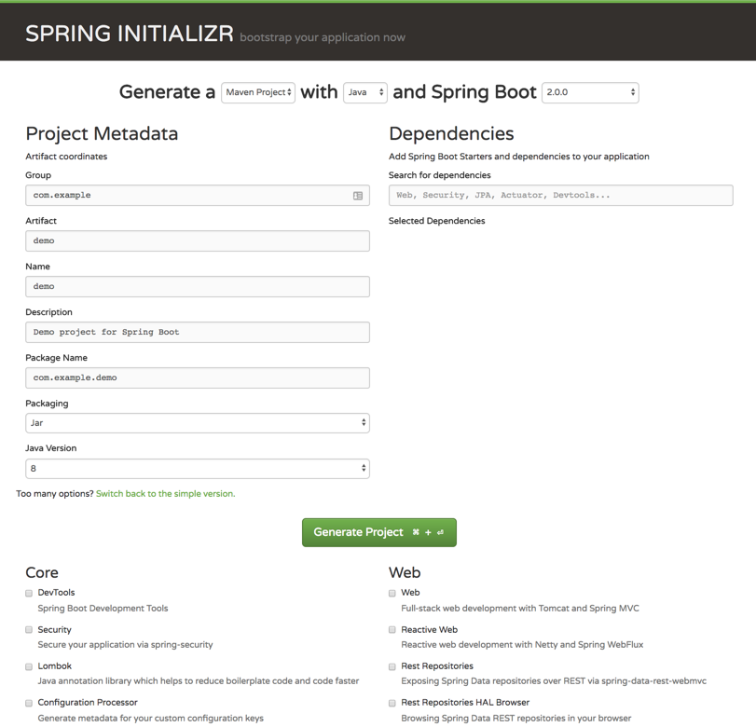
Spring Initializr
Build apps quickly with Spring Starter
http://start.spring.io

Slide 4
Resources
Pivotal home – pivotal.io
Pivotal Cloud Foundry Platform – pivotal.io/platform
Perficient home - www.perficient.com
Perficient services - www.perficient.com/services
Pivotal eBooks – pivotal.io/ebooks
Migrating to Cloud-Native Application Architectures - http://goo.gl/i0wwV8
The Cloud Native Journey, by Duncan Winn - http://goo.gl/Z3XLm7
Leading Enterprise Platform powered by Cloud Foundry - http://goo.gl/XfMp8h
The Cloud Native Journey Webinar Series - http://goo.gl/BOkxxj
Customer stories - https://www.youtube.com/watch?v=5q-ntJOKYA4
Pivotal and Perficient

Slide 5
St. Louis Local Events
Saint Louis Cloud Foundry Meetup meetup.com/Saint-Louis-Cloud-Foundry-Meetup/
Saint Louis Spring Spring Users Group meetup.com/Saint-Louis-Spring-Meetup/
St. Louis Java Users Group meetup.com/GatewayJUG/
Meetups
http://meetup.com

Slide 6
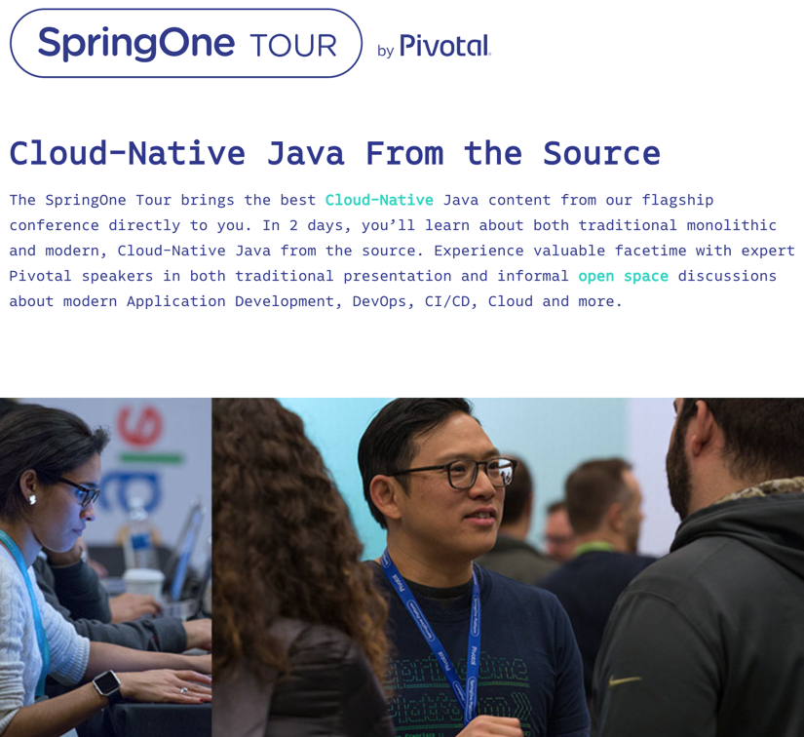
SpringOne Tour St. Louis May 30-31, 2018
Location T-Rex 911 Washington Ave St. Louis, MO 63101 https://springonetour.io/2018/st-louis
https://springonetour.io/

Slide 7
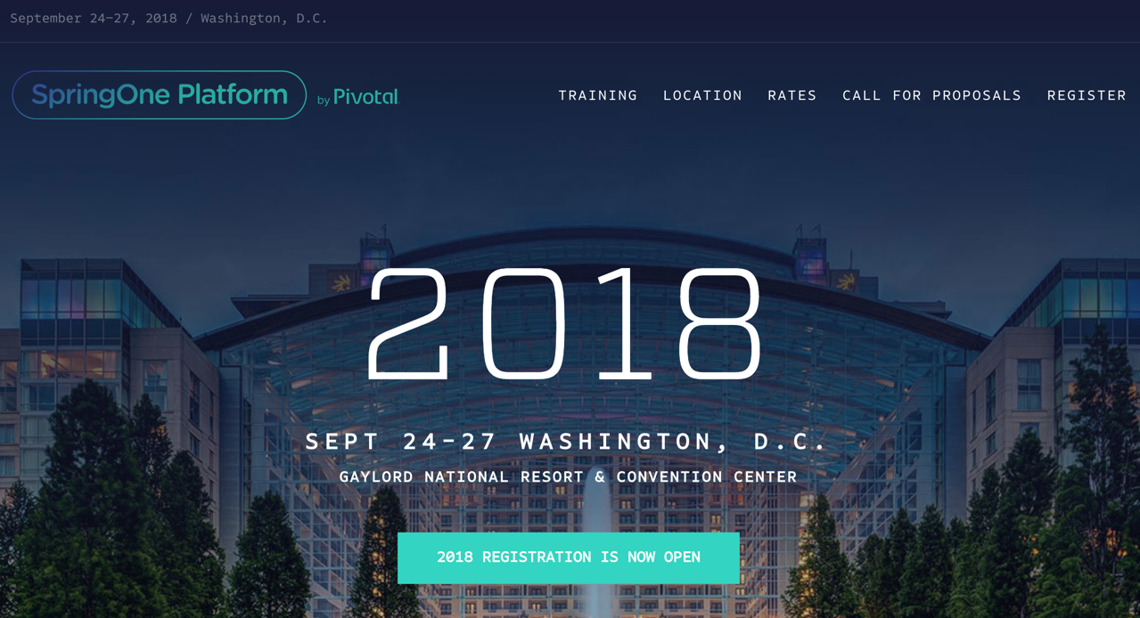
https://springoneplatform.io/

Slide 8
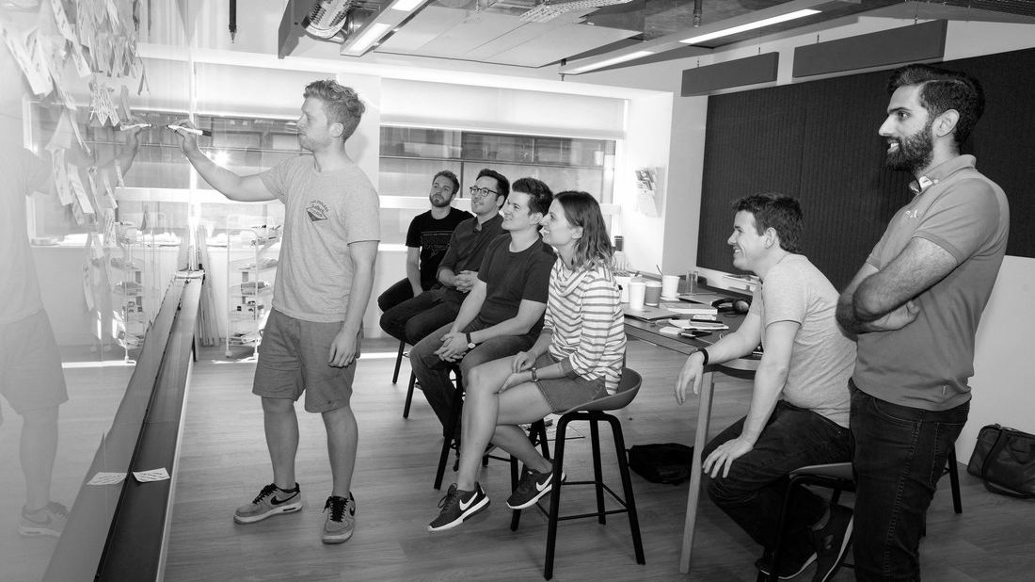
Evaluations - PLEASE fill out

Slide 9
Q&A, Comments, Suggestions

Slide 10
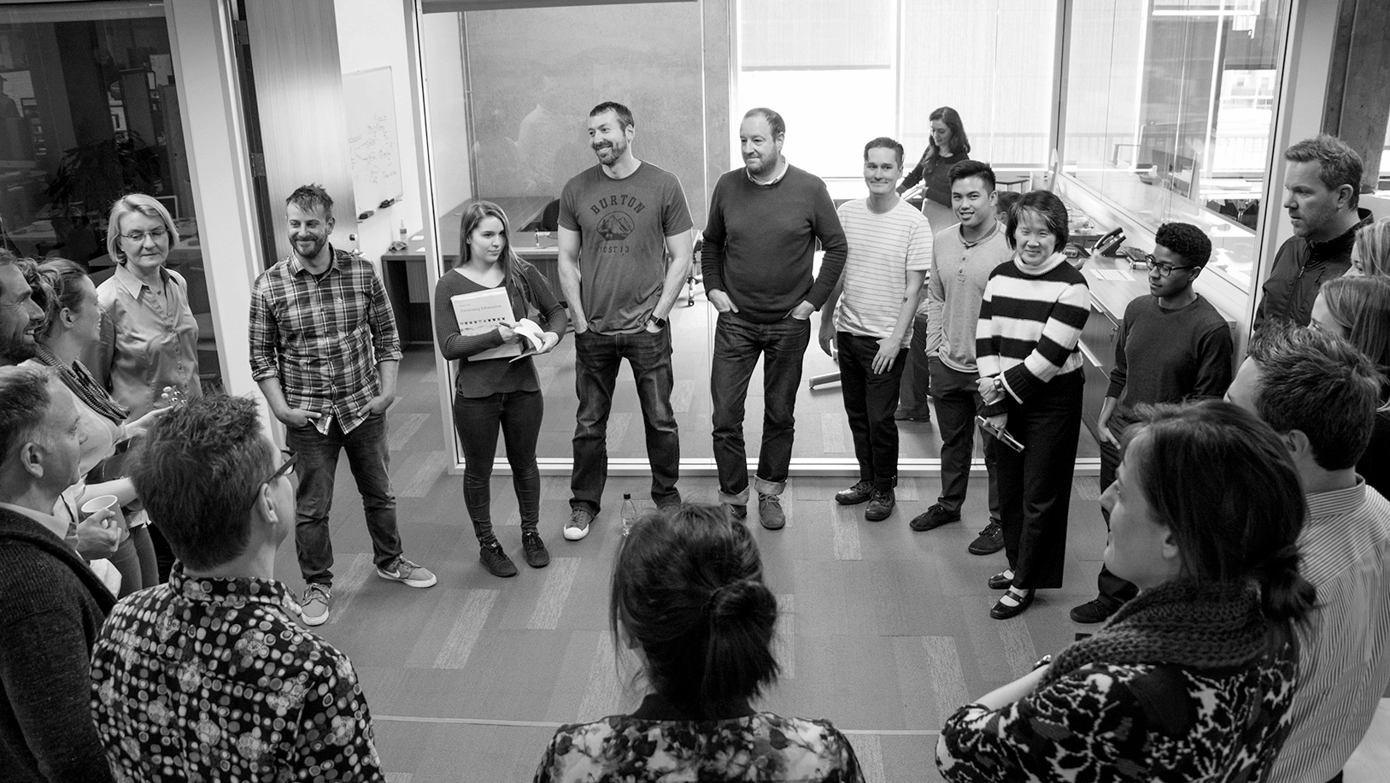
Transforming How The World Builds Software
© Copyright 2018 Pivotal Software, Inc. All rights Reserved.

